Slide 1


Project: record and calculate nutrition
Junyu Mou

Slide 2


What can be done?
Input personal information
Calculate daily nutrition needed based on weight
Input foods
Calculated nutrition consumption
Record food input history
Generate report with date

Slide 3
PART 1: personal information
Input file
Get information
Store information
Print welcome screen
Write on report
Import personal information(.txt) file
The program read the file
Get useful information only (name, weight etc.)
Print a welcome screen for program with name, weight and date
This part has a class which can check all information added so far and write the information into the report

Slide 4
Part 2: set nutrition goal
Enter protein in grams
Check input type
Enter carbohydrate in grams
Check input type
Calculate both
Print goals in software
method
Enter protein in grams per kg of body weight
Enter carbohydrate in grams per kg of body weight
Calculate protein and carbohydrate goal
Print out the goal for program

Slide 5
PART 3: input foods and establish food library
Enter food_name and weight
If: not in saved data
Save information
Enter Nutrition information
Else:
continue
Load saved data
while
Open, read and import saved data
continue
Input foods and weight of the food
if no records for the food: enter information
All records will be saved everlastingly

Slide 6
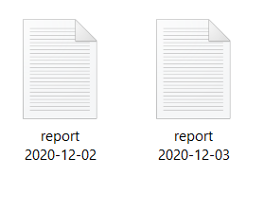
PART 4: calculate the day’s nutrition consumption, compare with goal and write on report
Calculate the day’s nutrition consumption
Compare the consumption with goal
All data written in report
Calculate day’s accumulated data about protein carbohydrate and vegetable
Compare goal with the consumption
All results are written in the report

Slide 7
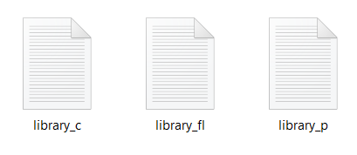
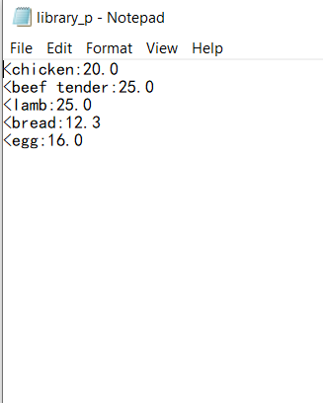
PART 5: save all data in (.txt) files
Reopen (.txt) files where used to save food records
Write all data from food library lists and dictionary into files
Close files

Slide 8
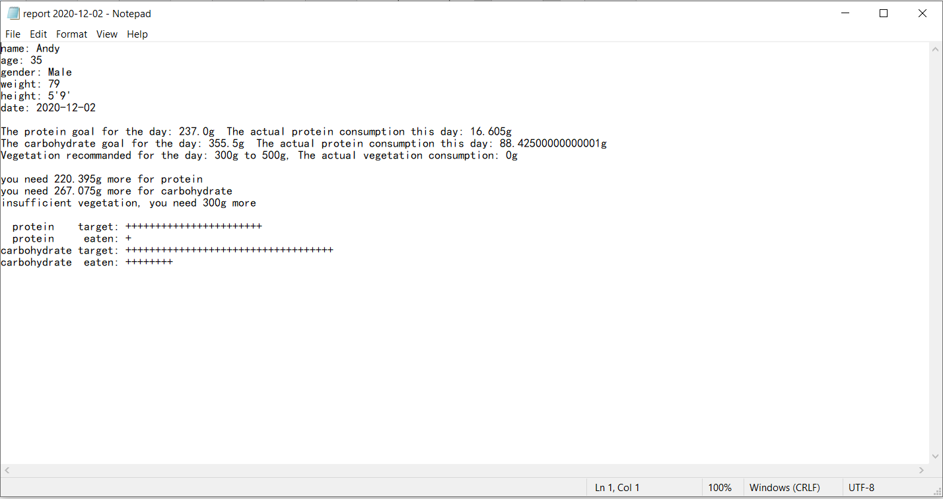
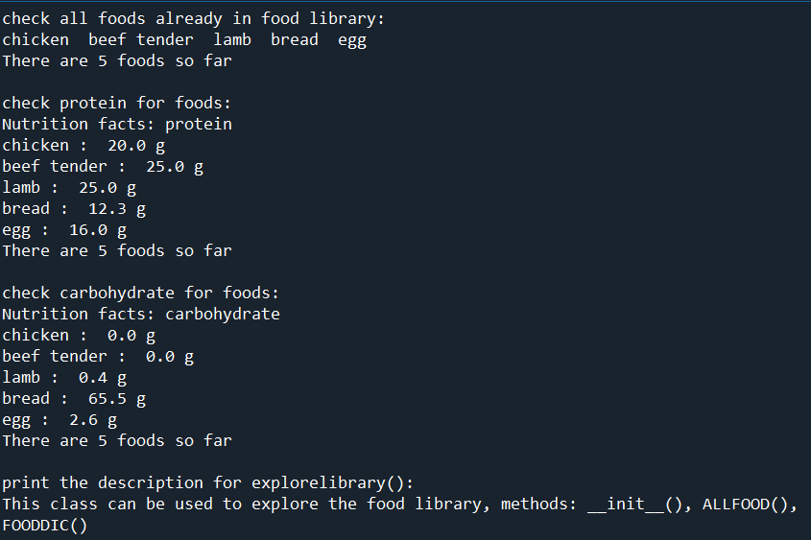
RESULT
Example of report
Also has build-in functions to check the information in the program

